Slide 1
BUSINESS REQUIREMENTS
Nabajyoti/ Sonal/Varun
EPMP

Slide 2
BUSINESS VALUES
Nabajyoti/ Sonal/Varun
EPMP

Slide 3
USER EXPERIENCE DESIGN
Nabajyoti/ Sonal/Varun
EPMP

Slide 4
BUSINESS PROCESS DIAGRAM
Nabajyoti/ Sonal/Varun
EPMP

Slide 5
INFORMATION ARCHITECTURE DIAGRAM
Nabajyoti/ Sonal/Varun
EPMP

Slide 6
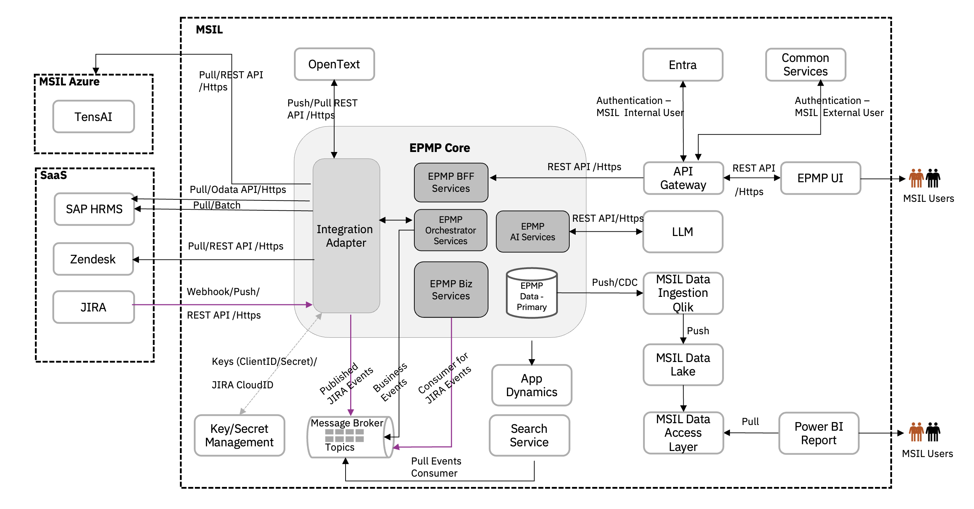
Integration Architecture

Slide 7
APPLICATION ARCHITECTURE DIAGRAM
EPMP

Slide 8
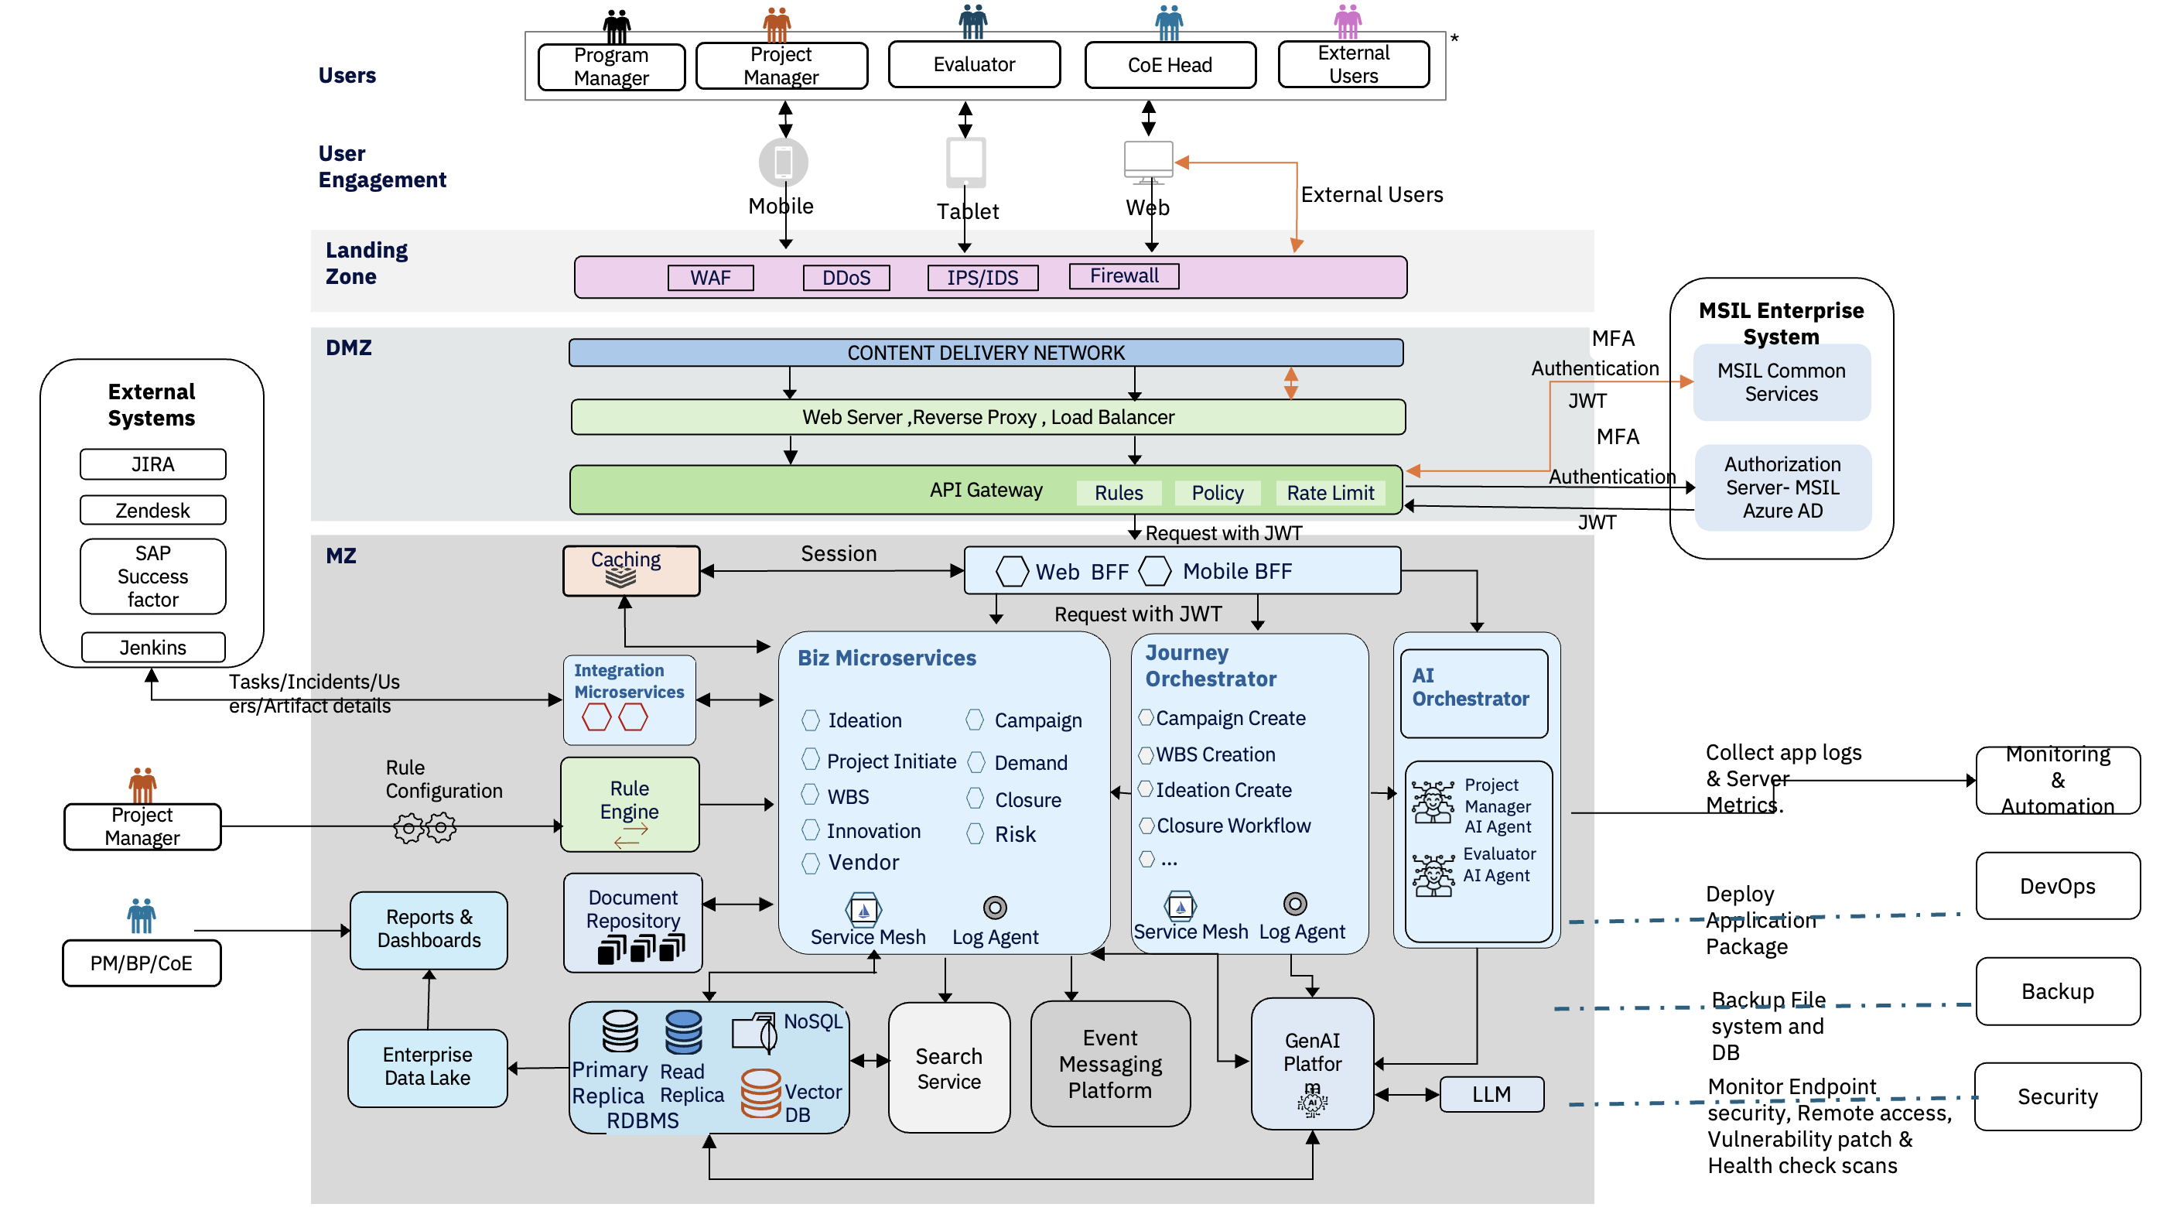
Technical Architecture

Slide 9
Component Descriptions
Layer | Component | Technical Description
User Engagement | EPMP Mobile App | Mobile client delivering on-the-go access to approvals, task actions, status updates and alerts. Optimised for variable network conditions and simplified interaction patterns.
User Engagement | EPMP Web Portal | Primary browser-based application for dashboards, workflow actions, configuration, reporting and collaboration. Supports role-based UI composition and enterprise access controls.
Landing Zone | WAF (Web Application Firewall) | Protects EPMP web and API endpoints by inspecting HTTP/HTTPS requests and blocking malicious payloads such as SQL injection, XSS, and API abuse. Enforces rule-based filtering, rate limiting, and bot protection before traffic reaches the API Gateway.
Landing Zone | DDoS Protection | Safeguards EPMP availability by detecting and mitigating large-scale traffic floods (Layer 3/4/7 attacks). Automatically absorbs and filters volumetric attacks to ensure system uptime and consistent performance under abnormal traffic conditions.
Landing Zone | Firewall | Controls inbound and outbound network traffic using predefined security rules. Segregates EPMP environments (public, private, internal services) and restricts access to only trusted IP ranges, ports, and protocols, forming a foundational network security boundary.
Landing Zone | IDS/IPS | Monitors and analyzes network traffic for suspicious or malicious activity. IDS provides real-time detection and alerting, while IPS actively blocks or prevents identified threats. Enhances EPMP security through deep packet inspection and anomaly detection across internal and external traffic flows.
DMZ | Content Delivery Network | Edge distribution layer for static content, API acceleration and low-latency delivery. Also helps absorb traffic bursts and improves end-user response time.
DMZ | Reverse Proxy / Load Balancer Layer | Ingress layer that terminates TLS, balances traffic and forwards requests to APIs or BFF services. Supports high availability and routing controls.
DMZ | API Gateway | Single entry point for client and partner APIs, handling authentication, routing, throttling, request validation and observability. Enforces consistent API governance. Request handling rules such as header checks, schema validation, conditional routing and consumer-specific behaviour at the gateway edge. Security and governance policies including auth enforcement, CORS, request/response transformation and consumer access constraints. Rate Limiting controls request volumes to protect downstream services and ensure fair usage for channels and external consumers.

Slide 10
Component Descriptions
Layer | Component | Technical Description
Identity | Authorization Server - MSIL Entra AD | Enterprise identity provider issuing tokens and managing SSO, group membership and access lifecycle for MSIL EPMP users.
Identity | Authorization Server – MSIL Common Services | Enterprise identity provider issuing tokens and managing SSO, group membership and access lifecycle for external users.
BFF | Web BFF | Client-specific backend that aggregates data for the web portal, reduces chatty calls and performs light response shaping for dashboards and screens.
BFF | Mobile BFF | Mobile-optimised backend exposing lean payloads, mobile-specific orchestration and channel-specific controls for latency and bandwidth efficiency.
Application | Biz Microservices | Core domain microservices implementing ideation, project initiation, WBS, execution, closure and related business capabilities. Own their business logic and service contracts.
Application | Journey Orchestrator | Coordinates long-running workflows such as campaign creation, WBS progression, approvals and closure using state management, retries and timeout handling.
Application | AI Orchestrator | Coordinates AI Agent workflows .
Application | Rule Engine | Executes configurable decision logic such as approval matrix, rules, validations and threshold-based policies. Should support admin-managed changes.
Application | Caching | In-memory cache for frequently accessed reference data, session-adjacent data, hot reads and derived responses to reduce latency and backend load.
Application | Integration Microservices | Anti-corruption services that isolate EPMP core from external systems through protocol conversion, mapping, retries and resilience controls.

Slide 11
Component Descriptions
Layer | Component | Technical Description
Data / Analytics | BI Dashboard and Reporting | Provides MIS, KPI dashboards, portfolio reporting and executive decision-making.
Data / Analytics | Enterprise Data Platform | Separates analytical consumption from transactional workload.
Data / Content | Document Repository | Stores project artefacts, supporting documents, evidence and attachments with controlled access, metadata and retrieval support. ECM ( Opentext) will be used to store documents. ECM is deployed MISIL on premises and presently being authenticated with MSIL Entra ID.
Data | RDBMS | Relational system of record for structured transactional data such as projects, tasks, approvals, master data references and audit-linked entities.
Data | NoSQL | Schema-flexible store for high-volume metadata, activity streams, de-normalised views, session-like data or selective event-driven materialisations and logging data.
Data | Search Service | Indexing and query service enabling fast full-text search, faceting, filters and relevance-based retrieval across projects, WBS, documents and metadata.
Integration | Event Messaging Platform | Provides asynchronous communication backbone for system events, decoupled processing, notifications and integration triggers.
Gen AI | AI Orchestrator | Coordinates GenAI workflows by routing requests, invoking appropriate models/agents, and managing multi-step reasoning or tool execution.
Gen AI | Persona-Based Agents | Task-specific AI agents aligned to user roles (e.g., PM, CoE Head) that execute contextual actions, reasoning, and decision support within EPMS workflows.
Gen AI | LLM (Large Language Model) | Core AI model that processes natural language, generates responses, and performs reasoning based on prompts and contextual inputs.
Gen AI | Vector Database | Stores embeddings of EPMS data to enable semantic search, retrieval-augmented generation (RAG), and context-aware AI responses.
Gen AI | GenAI Platform | Provides foundational capabilities for model hosting, prompt management, guardrails, monitoring, and integration of AI services within EPMS.

Slide 12
Component Descriptions
Layer | Component | Technical Description
Observability / Platform | Log Agent | Collects application and infrastructure logs, metrics and traces from services and runtime components for monitoring and troubleshooting.
Observability / Platform | Service Mesh | Provides service-to-service traffic control, mTLS, observability and policy enforcement for microservice communication.
External Systems | JIRA | Third-party project, issue or development tracking platform integrated with EPMP for synchronisation of tickets or status.
External Systems | Jenkins | Build and deployment automation tool that may exchange pipeline status, package metadata or automation triggers with EPMP platform.
External Systems | SuccessFactors | HR platform used for employee, organisation, role or resource-related reference data in EPMP.
External Systems | Zendesk | Customer/support platform that can provide ticketing data, issue references or support workflow integration into EPMP.

Slide 13
TECHNICAL ARCHITECTURE DIAGRAM
EPMP

Slide 14
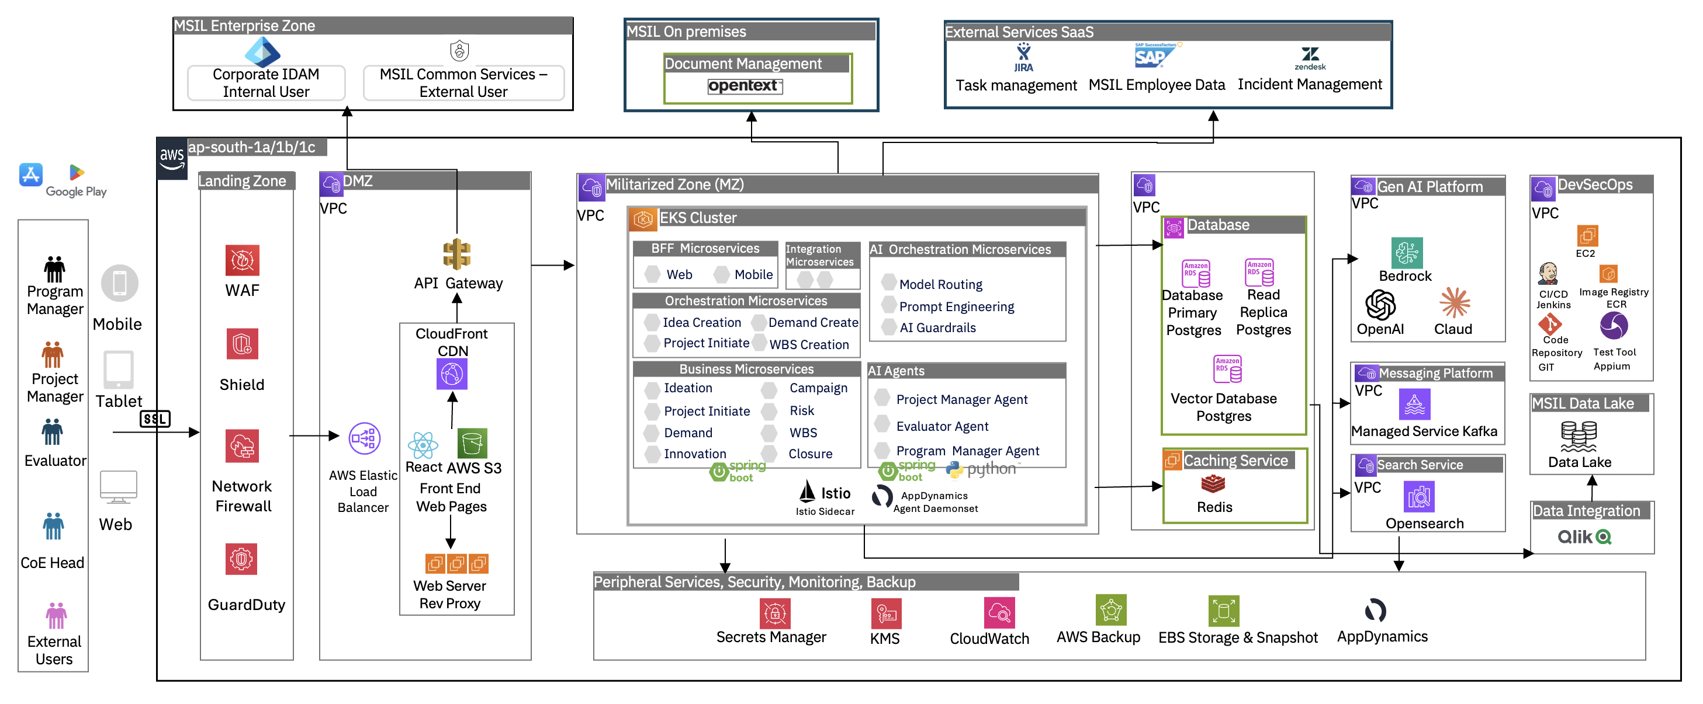
Deployment Architecture

Slide 15
SECURITY ARCHITECTURE DIAGRAM
EPMP

Slide 16
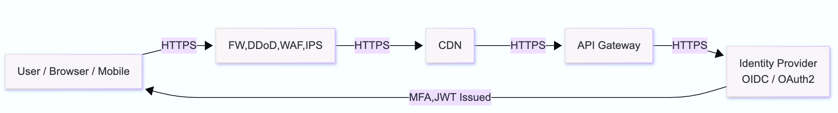
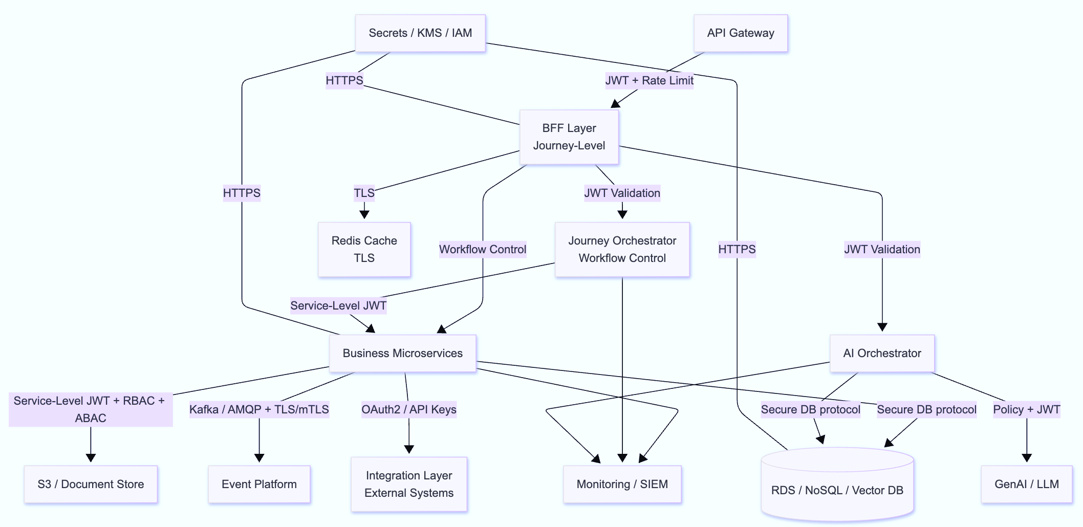
Security Architecture
DMZ
MZ

Slide 17
Security Architecture Details
Source Component | Target Component | Communication Purpose | Protocol / Communication Type | Security Mechanism | Authentication / Authorization | Remarks
User Browser / Mobile App | CDN | Access static content, web assets | HTTPS | TLS 1.2+ / 1.3 | Public access or token-aware access as applicable | CDN should enforce HTTPS only
User Browser / Mobile App | Reverse Proxy / Load Balancer | Entry point for UI/API traffic | HTTPS | TLS 1.2+ / 1.3 | Token forwarding / session propagation/MFA | SSL termination can happen at LB or gateway as per design
External User | Web Portal | Access EPMS over internet | HTTPS | TLS 1.2+ / 1.3, WAF rules, DDoS protection | JWT / SSO via Azure AD/MFA | External user access should be restricted via policy and role checks
Reverse Proxy / Load Balancer | API Gateway | Route application/API requests | HTTPS | TLS | Mutual trust within controlled zone, optional mTLS | Prefer encrypted internal hop also
API Gateway | Azure AD / Authorization Server | Authentication and token validation | HTTPS/REST | TLS | OAuth 2.0 / OpenID Connect / JWT validation | Gateway validates issuer, audience, expiry, signature
API Gateway | MSIL Common Services | Enterprise service access | HTTPS / REST | TLS | Service account / OAuth2 / JWT | Depends on common service contract
API Gateway | Web BFF / Mobile BFF | Forward authenticated API requests | HTTPS / REST | TLS | JWT propagation | Gateway should pass validated user claims
Web BFF / Mobile BFF | Caching Layer | Session/context/cache lookup | TLS-enabled Redis protocol | TLS, network isolation | Auth token / Redis auth / IAM as applicable | Do not keep sensitive business data in plain cache
Web BFF / Mobile BFF | Biz Microservices | Business API calls | HTTPS / REST or gRPC | TLS, preferably mTLS in service mesh environments | JWT propagation, service authorization | User claims may be forwarded for downstream authorization
Web BFF / Mobile BFF | Journey Orchestrator | Initiate business workflows | HTTPS / REST / gRPC | TLS, preferably mTLS | JWT + service authorization | Orchestrator should revalidate permissions for workflow actions
Web BFF / Mobile BFF | AI Orchestrator | Invoke AI-enabled features | HTTPS / REST | TLS | JWT + policy-based authorization | Sensitive prompts and outputs should be audited
Biz Microservices | Biz Microservices | Inter-service domain communication | REST / gRPC | mTLS via service mesh | Service identity + JWT/pass-through claims where needed | Recommended to use Istio/App Mesh mTLS
Biz Microservices | Journey Orchestrator | Workflow coordination | REST / event call | mTLS or TLS | Service-to-service auth | Long-running processes should use signed and traceable requests
Biz Microservices | Integration Microservices | External system invocation | REST / async trigger | TLS / mTLS | Service authentication | Adapter acts as anti-corruption and isolation layer
Biz Microservices | Document Repository | Store/retrieve documents | HTTPS / API / SDK | TLS | Service auth / IAM / signed URL / access token | Documents should be encrypted at rest
Biz Microservices | RDBMS | Transactional data persistence | Native DB protocol | TLS | DB user / IAM auth / secret-managed creds | Restrict direct DB access to service accounts only
Biz Microservices | NoSQL / Vector DB | Metadata / AI / flexible data access | Secure DB protocol | TLS | Service account / IAM / DB creds | Apply network segmentation and scoped permissions

Slide 18
Security Architecture Details
Source Component | Target Component | Communication Purpose | Protocol / Communication Type | Security Mechanism | Authentication / Authorization | Remarks
Biz Microservices | Rule Engine | Rule evaluation / decision lookup | REST | TLS / mTLS | Service authentication | Rule changes should be admin-controlled and audited
Biz Microservices | Event Messaging Platform | Publish domain events | AMQP / Kafka | TLS, preferably mTLS if supported | Producer auth via cert / IAM / SASL | Events should carry minimal sensitive data
Biz Microservices / Orchestrator / AI Orchestrator | Log Agent / Monitoring | Send logs, traces, metrics | Agent protocol | TLS | Agent/service identity | Avoid logging secrets, tokens, or PII
Journey Orchestrator | Event Messaging Platform | Publish workflow events | AMQP / Kafka | TLS | Producer identity / IAM | Workflow audit events recommended
Integration Microservices | Event Messaging Platform | Publish integration events | AMQP / Kafka | TLS | Producer auth | Good for decoupled webhook processing
Integration Microservices | External Systems (JIRA, Zendesk, SAP SuccessFactors, Jenkins) | System-to-system integration | HTTPS / REST / Webhook / Odata API | TLS 1.2+ / 1.3 | OAuth2, API key, Basic Auth, signed webhook, service credentials | Auth model depends on external system
GenAI Platform | LLM | Model inference call | HTTPS / API | TLS | Platform-managed credentials / IAM | Prefer private endpoint if available
AI Orchestrator | GenAI Platform | Prompt/response invocation | HTTPS / API | TLS | API key / IAM / OAuth depending on platform | Apply prompt guardrails and response filtering
AI Orchestrator | Vector DB | Semantic retrieval | Secure DB Protocol / API | TLS | Service auth | Retrieval scope should respect user authorization
Reports & Dashboards | Enterprise Data Lake | Reporting / analytics access | HTTPS / API | TLS | IAM / service role / RBAC | BI access should be role-restricted
Project Manager / Admin UI | Rule Engine | Rule configuration | HTTPS | TLS | RBAC, admin privileges | High-risk operation; must be audited
Search Service | RDBMS / NoSQL / Vector DB | Read indexed source data | Secure DB / API | TLS | Service account | Prefer controlled ingestion path over broad DB access
Platform / Monitoring | Incident Management Tool | Raise alerts / incidents | HTTPS / API | TLS | API token / service account | For Sev1/Sev2 operational alerts
Backup Systems | Databases / File Systems | Backup and restore | Secure backup protocol | TLS + encryption at rest | Backup service identity | Backup copies must also be encrypted
DevOps / CI-CD | Runtime Platform / EKS / Services | Deployment / rollout | HTTPS / kubectl / pipeline integration | TLS | IAM role / service account / signed artifacts | Enforce signed builds and least privilege
Security Tools | Endpoints / Workloads | Vulnerability scan / compliance check | Secure agent/API | TLS | Managed service identity | Findings should feed central monitoring

Slide 19
NON-FUNCTIONAL REQUIREMENTS
EPMP

Slide 20
Category | Non-functional requirement | Requirements | Specifications
System Load |  |  | Current | Future in 1 year | In 2 years | In 3 years
 | Total number of users of the system |  | 30,000
 | Number of concurrent users at peak time |  | 3,000
 | Number of concurrent users (average) |  | 1,800
Response Time | Target & Maximum Response Time (seconds) for different categories (add categories as per project need)
 | Landing page / Main Screen |  | <500 ms
 | Normal pages |  | <500 ms
 | Dashboard/heavy processing page |  | 1 sec
 | Reports |  | 1 sec
 | Threshold for service API (for non UI applications) |  | <=1 Sec
 | Target acceptance criteria like response time on 95 percentile of requests |  | <=2 Sec
 | Background task completion |  | <=30 Sec
 | Asynchronous notifications |  | <=5 Sec
Performance & Integration | Availability & Reliability
 | Business-as-usual uptime SLA (e.g., 99.9% / 99.95%) |  | 99.90% | 99.90% | 99.90% | 99.90%
 | Planned vs unplanned downtime | Planned- max 1 hour/month unplanned- <=0.1% monthly downtime
 | Active‑active / active‑passive setup | TBD
 | Observability & Monitoring | Required
 | Application metrics (CPU, memory, latency) | Server CPU, Memory, Latency.
 | Centralized logging- Operational logs | Yes
 | Alerting & escalation | Yes
 | Dashboard availability (Grafana/App Insights/etc.) | App Dynamics , API monitoring
 | API versioning | Required
 | External dependency SLAs | <1.5 sec for SaaS based API response time
 | Retry & timeout policies | 3 retries and
 | DevOps & Release Management | Required
 | Zero‑downtime deployment | Yes
 | Rollback strategy | Yes

Slide 21
Category | Non-functional requirement | Requirements | Specifications |  |  |  | Category | Non-functional requirement
Security | Database encryption needed specify the tables, fields etc. | Encrypted at Rest and Transit
 | Anonymize PII in backups & analytics datasets | yes
 | Encryption mechanism to be used in Application | Specify
 | Communication between App, DB or other internal server needs to be controlled? | yes
 | Communication with external systems needs to be controlled? | yes
 | Communication protocol for external system integration | REST
 | Authentication mechanism for external system integration | OAuth2
 | SSL required for external APIs? | Yes
 | User is not allowed to access any url directly without login | Yes
 | Security threats like SQL injection | Yes
 | Security acceptance criteria like HCL AppScan
 | Role‑based access control (RBAC) | Yes
 | Maker–checker approval workflows | Yes
 | IP whitelisting enabled | Yes
 | HMAC signing for internal APIs | Yes
 | MTLS for high-security endpoints | Yes
 | Data masking in non‑prod environments | Yes
 | Session timeout & idle logout | 5 min
 | Secure key management (HSM / Vault)
Token Expiry & Session limits | JWT Expiry : 15 min
 | Idle timeout : 5 min
 | Absolute timeout : 8 hours

Slide 22
Category | Non-functional requirement | Requirements | Specifications
Audit and Edit trail
 | Audited elements- What business elements will be audited? | User master, role & access configurations, Customer id, transactions, approval workflow, configuration changes, reference data, policy/rule configuration
 | Audited fields- What data fields will be audited? | Action type (create/update/delete etc), Fields name, old/new value, timestamp, roles, approval status, access, PII fields etc
 | Audit file characteristics (Audit & compliance logs)- Timestamp, user id, role | User ID, Timestamp
 | Approval logs (who approved what, when) | Yes
 | Elements- What elements history needs to be maintained | Version history, records to be retrieved, system must support comparison between versions
 | Audit Monitoring & Compliance Reporting | Yes
Recovery and Backup
 | Custom Recovery process needed? | Yes
 | Disaster scenarios recovery timescales- How quickly does recovery takes to perform/ down time acceptable | RPO and RTO need to be specified in hours. RPO refers to the maximum duration of data loss that can be tolerated. RTO refers to the time required to resume operations after a disaster, typically from the Disaster Recovery (DR) site. |  | RPO = 15 minutes RTO = 1 hour
 | Backup frequency for disaster recovery - How often is backup taken for | Once a day or twice a day.
 | - Database (like Weekly full and Daily/ hourly transactional) | Daily full + hourly log backups
 | - Folders and files | Daily
 | - Set-up data | Once a day or twice a day.
 | - System state | Daily
 | - Code | On every release
 | Database purging / archival policy | Years or months.

Slide 23
Category | Non-functional requirement | Category | Current | Future in 1 year | In 2 years | In 3 years
Regulatory Compliance | Financial regulations (based on geography): SEBI (India), SEC / FINRA (US), GDPR / DPDP Act? | Yes
 | Data retention & archival rules | Yes
 | Audit log retention period | Years or months. TBD
Document Management | Maximum number of documents per month |  | 500 | 550 | 600 | 650
 | Average size of each document |  | 1-5 MB | 1-5 MB | 1-5 MB | 1-5 MB
User Experience | Chrome (latest + last 2 versions) | Yes
 | Microsoft Edge (Chromium, latest + last 2) | Yes
 | Safari (macOS & iOS – last 2 versions) | Yes
 | Desktop | Yes
 | Tablet | Yes
 | Mobile | Yes
 | Orientation support (portrait/landscape) | Yes
 | Internationalization and localization (application level / code level / log level) | No
 | Languages supported | English
 | Date time display | Yes
 | Currency | All
 | Time‑zone handling | All
 | Accessibility requirements | No
 | Text to speech | Yes
 | Speech to text | Yes
 | WCAG 2.1 AA compliance | Yes

Slide 24
Category | Non-functional requirement | Category | Current | Future in 1 year | In 2 years | In 3 years | Category | Non-functional requirement
Performance & System Load | System must handle 2x peak load for 30 min
 | System must handle 3x burst load for 5 min without failure
 | Auto-scaling must instantly respond to burst traffic
 | Batch processing window
 | End- of -day batch must finish within 45 minutes
 | End-of-month batch must finish within 4 hours
 | Queue Backlog tolerance
 | Queue backlog tolerance= max 5000 messages
 | System must auto-scale consumers when backlog>1000 messages
 | API Rate limits/ Throttling specs
 | Rate limit= 300 requests/min per user, 1000 requests/min per client app
 | On throttling: return HTTP 429 + Retry-After header
 | Client must backoff and retry
UX- Messaging Standards | Error messages must not expose stack trace, DB info
Graceful Degradation | Use cached data for 10 min
 | Make portal raed-only
 | Disable non-critical features
Virus Scanning | All uploads scanned with anti-malware
 | Allowed file types restricted
Retention Duration | KYC: 10 years
 | Contracts: 7 years
 | Logs (System/application) : 1 years, Security Logs : 3 years, Audit Logs : 7 years

